Slide 1

MADE BY KRISHNA

Slide 2

Class 9 Science - Chapter 1 Notes
MADE BY KRISHNA
1. What is Matter?- Matter is anything that has mass and occupies space.- Examples: air, water, sugar, sand, etc.
2. Physical Nature of Matter:- Matter is made up of tiny particles.- These particles are very small and cannot be seen by the naked eye.- Particles have spaces between them.- They are continuously moving (have kinetic energy)
3.Characteristics of Particles of Matter:- They have space between them.- They are continuously moving

Slide 3

4. States of Matter: a) Solid: - Definite shape and volume. - Tightly packed particles with strong attraction. - Cannot be compressed
b) Liquid: - No definite shape but definite volume. - Particles have less force of attraction than solids. - Can flow and take shape of container
c) Gas: - No definite shape or volume. - Particles are far apart and move freely. - Highly compressible
5. Change of State of Matter:- Matter changes state on changing temperature or pressure.- Melting: Solid to Liquid- Freezing: Liquid to Solid- Boiling: Liquid to Gas- Condensation: Gas to Liquid- Sublimation: Solid
MADE BY KRISHNA

Slide 4
6. Latent Heat:- Heat energy absorbed or released without change in temperature.- Latent heat of fusion (solid to liquid)- Latent heat of vaporization (liquid to gas
7. Evaporation:- Surface phenomenon where liquid changes to gas below boiling point.- Factors affecting evaporation: a) Surface Area (more = faster) b) Temperature (higher = faster) c) Humidity (less humidity = faster) d) Wind Speed (more = faster)- Evaporation causes cooling (example: sweating)
MADE BY KRISHNA

Slide 5
8. Differences Between Evaporation and Boiling:- Evaporation is a surface phenomenon, slow, occurs at any temp.- Boiling is a bulk phenomenon, rapid, occurs at fixed temp
MADE BY KRISHNA

Slide 6
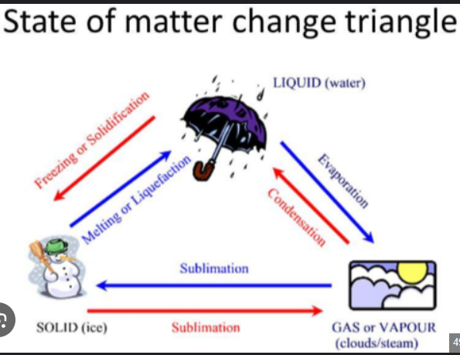
MADE BY KRISHNA

Slide 7


